Slide 1
Audit Module
Mockups
05-June-2025

Slide 2
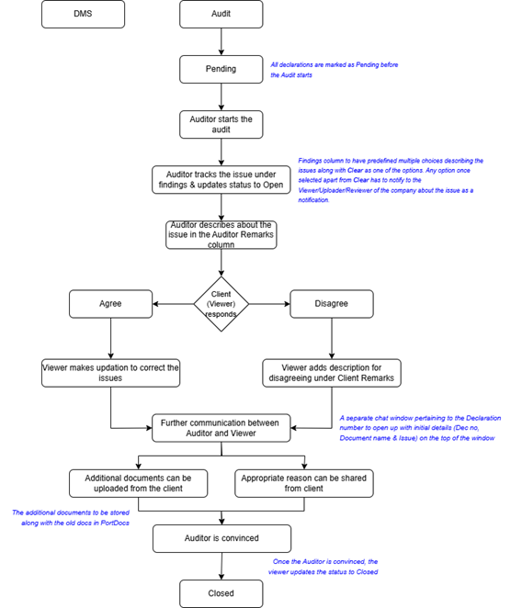
Workflow

Slide 3
Product Owner

Slide 4
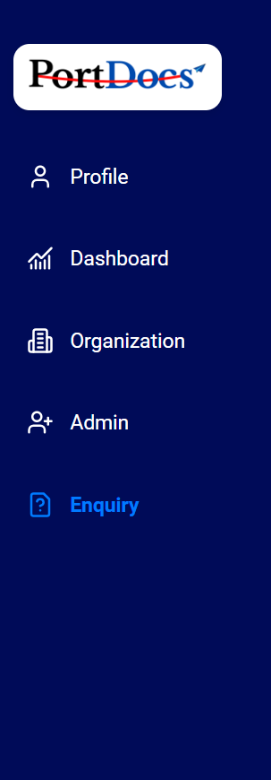




Audit Home
Welcome to Audit Portal!
User Creation
Assign Auditor to Manager
Assign Company to Auditor
Audit Status by Company
Audit Load by Auditor
Reconciliation Audit
Audit

Slide 5


Audit Home
User Creation – Auditor & Audit Manager
User Name *
Person Name *
Mobile*
Mail ID *
Audit Type *
Freezone Company
Mainland Company
Warehouse
Broker/Agent
Manager
Auditor
Role *
Audit
Cancel
Create

Slide 6
Audit Home
Assign Auditor to Manager
Manager
Assign Auditor
|
|
Ragu
Raja & Kumar
Suresh
Kumar
Vimal
Raja
Sundar
Suresh
Joel
Mani
Audit
Cancel
Assign

Slide 7



Audit Home
Assign Company to Auditor
Company Code
Company Name
Company Type
Auditor
AE-2347346576
DHL
FZ
|
X
Raja & Kumar
AE-7634567567
AL FUTTAIM
Mainland
Kumar
Raja
AE-7457346573
NINJAVAH LOGISTICS
Broker
Suresh
Mani
AE-7846374657
NAQUEL LOGISTICS
Warehouse
Kumar
Audit
AE-3847567845
MONSANADA LOGISTICS
Mainland
Suresh

Slide 8
Audit Home
Audit Status Summary – Company wise
Declarations Based Count
Company Code
Company Name
Manager
Auditor
Open
Pending with Client
Pending
with Auditor
Closed
Ragu
Raja
AE-2347346576
DHL
20
5
10
3
Suresh
Raja & Kumar
AE-7634567567
AL FUTTAIM
8
20
2
1
Vimal
Kumar
AE-7457346573
NINJAVAH LOGISTICS
5
0
5
0
Sundar
Suresh
AE-7846374657
NAQUEL LOGISTICS
20
6
12
0
Audit
Joel
Mani
AE-3847567845
MONSANADA LOGISTICS
4
10
4
0

Slide 9
Audit Home
Audit Status Summary – Auditor wise
Declarations Based Count
Auditor
Assigned Company
Closed
Open
Pending with Client
Pending
with Auditor
Raja
23
20
5
10
2
Raja & Kumar
15
8
20
2
10
Kumar
13
5
0
5
2
Audit
Suresh
20
20
6
12
3
Mani
7
4
10
4
0

Slide 10
Audit Home
Reconciliation Audit Status Summary
Company Code
Company Name
Uploaded Date
Manager
Auditor
Status
AE-2347346576
DHL
05/07/2024
Ragu
Raja
Closed
AE-7634567567
AL FUTTAIM
05/07/2024
Suresh
Raja & Kumar
In-Progress
AE-7457346573
NINJAVAH LOGISTICS
05/07/2024
Vimal
Kumar
In-Progress
AE-7846374657
NAQUEL LOGISTICS
Sundar
Suresh
Open
AE-3847567845
MONSANADA LOGISTICS
Joel
Mani
Closed
Audit

Slide 11



Audit Home
Reconciliation Audit
Code: AE-2347346576
DHL
Year
|
Everyone
Auditor
Document
Name
Document 1
Document 2
Document 3
Month
January
February
March
April
May
June
Uploaded
Date
5/1/2025
4/2/2025
2/3/2025
Stock
Report
Stock 1
Stock 2
Stock 3
Customs
Transaction Report
Customs Transaction 1
Customs Transaction 2
Customs Transaction 3
Reconciliation Report
Reconciliation Report 1
Reconciliation Report 2
Status
Closed
Closed
In-Progress
Open
NA
NA
2347346576543
Auditor
There’s an incorrect currency value in invoice 2347346576543..
Manager
Did you inform the client?
Auditor
Yes, they’re re-uploading the corrected version.
Manager
Good. Verify once it's updated.
Audit
Adhoc Reconciliation Report
Adhoc 1 2/4/2024 2/4/2025 Stock Customs Transactions Reconciliation Adhoc1 Closed
Adhoc1 Adhoc1
Adhoc 2 2/4/2025 1/6/2025 Stock Customs Transactions Reconciliation Adhoc2 Closed
Adhoc2 Adhoc2
Messaging Disabled

Slide 12
Manager

Slide 13
Auditor Dashboard
|
|
Year
Month
Declarations Based Count
Closed
Pending with Client
Pending with Auditor
Auditors
Auditor
Assigned
Open
Companies
Raja
23
20
5
10
0
Raja & Kumar
15
8
20
2
1
Stock Audit
Kumar
13
5
0
5
1
Suresh
20
20
6
12
1
Mani
7
4
10
4
0

Slide 14
Auditor Status – Company wise
|
|
Year
Month
Auditor : Suresh
Declarations Based Count
Company Code
Company Name
Type
Closed
Open
Pending with Client
Pending with Auditor
Auditors
Auditor List
AE-2347346576
Company List
DHL
FZ
20
5
10
1
Companies
AE-7634567567
AL FUTTAIM
Mainland
8
20
2
1
Stock Audit
AE-7457346573
NINJAVAH LOGISTICS
Broker
5
0
5
2
AE-7846374657
NAQUEL LOGISTICS
Warehouse
20
6
12
2
AE-3847567845
MONSANADA LOGISTICS
Mainland
4
10
4
1

Slide 15
Auditor Status – Declaration wise
Auditor:
Suresh
DHL
Code:
AE-2347346576
Auditors
Auditor List
Everyone
Auditor
Dec No.
4567579807
2345987654
2345769807
4576980876
4357698076
Dec Date
5/1/2025
4/2/2025
2/3/2025
2/3/2025
2/3/2025
Issue Count
2
3
2
3
4
Auditor Findings
Wrong currency
Wrong CFI
Wrong Currency
Wrong Currency
Wrong CFI
Auditor
Remarks
Insert the correct currency
Insert the CFI value
Insert the correct currency
Client Response
Agree
Disagree
Disagree
Client Remarks
Updated latest doc
Actions
Completed
Not Started
In-Progress
Status
Closed
Pending with Client
Pending with Auditor
Open
Open
2347346576543
Company List
Companies
Auditor
There’s an incorrect currency value in invoice 2347346576543..
Manager
Did you inform the client?
Auditor
Yes, they’re re-uploading the corrected version.
Manager
Good. Verify once it's updated.
Stock Audit
Enter the message
Client

Slide 16
Company Dashboard
|
|
Year
Month
Declarations Based Count
Company Name
Type
Open
Pending with Client
Pending with Auditor
Auditor List
Company Code
Closed
Auditors
Companies
AE-2347346576
DHL
FZ
20
5
10
10
Company List
Stock Audit
AL FUTTAIM
Mainland
8
20
2
2
AE-7634567567
AE-7457346573
Broker
5
0
5
5
NINJAVAH LOGISTICS
AE-7846374657
NAQUEL LOGISTICS
Warehouse
20
6
12
12
AE-3847567845
MONSANADA LOGISTICS
Mainland
4
10
4
4

Slide 17
Audit Summary Report
|
|
Year
Month
Company Status – Declaration wise
Auditor:
Suresh
Code:
AE-2347346576
Declarations Audit Status
DHL
Open
Pending with Client
Pending with Auditor
Auditors
Closed
2
5
20
10
Companies
Findings Summary:
Declaration No
Stock Audit
Finding
2347346576345
Wrong Evaluation
3473467463457
Wrong Currency
3984734657634
HS Code Mistake
2379734657634
Wrong CFI Value
5678846576345
Wrong FOB Value
4547346576345
Wrong Insurance

Slide 18
Stock Audit Dashboard
|
|
Year
Month
Auditors
Company Code
Company Name
Uploaded Date
Manager
Auditor
Status
Companies
AE-2347346576
DHL
05/07/2024
Ragu
Raja
Closed
AE-7634567567
AL FUTTAIM
05/07/2024
Suresh
Raja & Kumar
In-Progress
Stock Audit
AE-7457346573
NINJAVAH LOGISTICS
05/07/2024
Vimal
Kumar
In-Progress
AE-7846374657
NAQUEL LOGISTICS
Sundar
Suresh
Open
Audit
AE-3847567845
MONSANADA LOGISTICS
Joel
Mani
Closed

Slide 19
Reconciliation Audit
Code: AE-2347346576
DHL
Year
|
Auditors
Everyone
Auditor
Document
Name
Document 1
Document 2
Document 3
Month
January
February
March
April
May
June
Uploaded
Date
5/1/2025
4/2/2025
2/3/2025
Stock
Report
Stock 1
Stock 2
Stock 3
Customs
Transaction Report
Customs Transaction 1
Customs Transaction 2
Customs Transaction 3
Reconciliation Report
Reconciliation Report 1
Reconciliation Report 2
Status
Closed
Closed
In-Progress
Open
NA
NA
2347346576543
Companies
Auditor
Please share the Customs Transaction Report for the month of March 2025. Only Stocks report is uploaded as of now.
Viewer
Oh, ok. Thanks for notifying. Uploaded now.
Auditor
Let me share the Reconciliation Report at the earliest.
Viewer
Thank you!
Stock Audit
Declaration Audit
Audit
Adhoc Reconciliation Report
Adhoc 1 2/4/2024 2/4/2025 Stock Customs Transactions Reconciliation Adhoc1 Closed
Adhoc1 Adhoc1
Adhoc 2 2/4/2025 1/6/2025 Stock Customs Transactions Reconciliation Adhoc2 Closed
Adhoc2 Adhoc2
Enter the message

Slide 20
Auditor

Slide 21
Audit Status – Company wise
|
|
Year
Month
Declarations Based Count
Company Name
Type
Open
Pending with Client
Pending with Auditor
Auditor List
Company Code
Closed
Declaration Audit
125
Company List
AE-2347346576
DHL
FZ
20
5
10
10
Stock Audit
2
AE-7634567567
AL FUTTAIM
Mainland
8
20
2
2
AE-7457346573
NINJAVAH LOGISTICS
Broker
5
0
5
5
AE-7846374657
NAQUEL LOGISTICS
Warehouse
20
6
12
12
AE-3847567845
MONSANADA LOGISTICS
Mainland
4
10
4
4

Slide 22
Open Declarations
Code:
DHL
AE-2347346576
Declaration Audit
Everyone
Manager
125
Dec No.
4567579807
2345987654
2345769807
4576980876
4357698076
Dec Date
5/1/2025
4/2/2025
2/3/2025
2/3/2025
2/3/2025
Issue Count
2
3
2
3
4
Auditor Findings
Wrong currency
Wrong CFI
Wrong Currency
Wrong Currency
Wrong CFI
Auditor
Remarks
Insert the correct currency
Insert the CFI value
Insert the correct currency
Insert the correct currency
Enter the message
Client Response
Agree
Disagree
Disagree
Client Remarks
Updated latest doc
Actions
In-Progress
In-Progress
Not Started
Status
Closed
Pending with Client
Pending with Auditor
Open
2347346576543
Stock Audit
Auditor
There’s an incorrect currency value in invoice 2347346576543..
Manager
Did you inform the client?
Auditor
Yes, they’re re-uploading the corrected version.
Manager
Good. Verify once it's updated.
2
Enter the message
Client

Slide 23
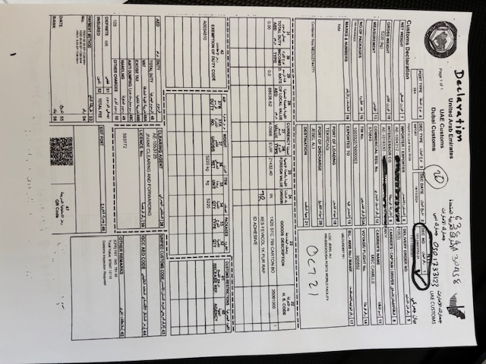
PortDocs
Declaration
Packing List
Invoice
Certificate of origin
Delivery Order
Others

Slide 24
Pending Stock Document
|
|
Year
Month
Declaration Audit
Company Code
Company Name
Uploaded Date
Manager
Auditor
Status
125
AE-2347346576
DHL
05/07/2024
Ragu
Raja
Closed
Stock Audit
2
AE-7634567567
AL FUTTAIM
05/07/2024
Suresh
Raja & Kumar
In-Progress
AE-7457346573
NINJAVAH LOGISTICS
05/07/2024
Vimal
Kumar
In-Progress
AE-7846374657
NAQUEL LOGISTICS
Sundar
Suresh
Open
Audit
AE-3847567845
MONSANADA LOGISTICS
Joel
Mani
Closed

Slide 25
Reconciliation Audit
Code: AE-2347346576
DHL
Year
|
Declaration Audit
Everyone
Manager
125
Document
Name
Document 1
Document 2
Document 3
Month
January
February
March
April
May
June
Uploaded
Date
5/1/2025
4/2/2025
2/3/2025
Stock
Report
Stock 1
Stock 2
Stock 3
Customs
Transaction Report
Customs Transaction 1
Customs Transaction 2
Customs Transaction 3
Reconciliation Report
Reconciliation Report 1
Reconciliation Report 2
Status
Closed
Closed
In-Progress
Open
NA
NA
2347346576543
Stock Audit
Auditor
Please share the Customs Transaction Report for the month of March 2025. Only Stocks report is uploaded as of now.
Viewer
Oh, ok. Thanks for notifying. Uploaded now.
Auditor
Let me share the Reconciliation Report at the earliest.
Viewer
Thank you!
2
Audit
Adhoc Reconciliation Report
Adhoc 1 2/4/2024 2/4/2025 Stock Customs Transactions Reconciliation Adhoc1 Closed
Adhoc1 Adhoc1
Adhoc 2 2/4/2025 1/6/2025 Stock Customs Transactions Reconciliation Adhoc2 Closed
Adhoc2 Adhoc2
Enter the message
Client

Slide 26
Reviewer & Viewer

Slide 27

Declaration Audit Status Summary
Code:
DHL
AE-2347346576
Dec No.
4567579807
2345987654
2345769807
4576980876
4357698076
Dec Date
5/1/2025
4/2/2025
2/3/2025
2/3/2025
2/3/2025
Issue Count
2
3
2
3
4
Auditor Findings
Wrong currency
Wrong CFI
Wrong Currency
Wrong Currency
Wrong CFI
Auditor
Remarks
Insert the correct currency
Insert the CFI value
Insert the correct currency
Insert the correct currency
Insert the correct CFI
Client Response
Agree
Disagree
Disagree
Client Remarks
Updated
Enter the message
Updated latest doc
Actions
In-Progress
In-Progress
Not Started
Status
Closed
Pending with Client
Pending with Auditor
Open
2347346576543
Auditor
I noticed there’s an incorrect currency value in the Invoice document
Viewer
Got it. I’ll double-check the source file and re-upload the corrected version.
Auditor
Yes please
Viewer
I’ve updated the document.
Declaration Audit
5
Stock
Audit
2
Enter the message

Slide 28
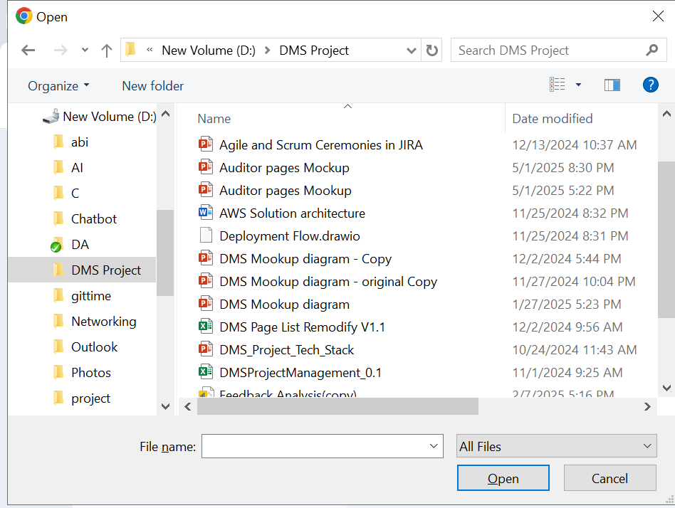
Declaration Audit Status Summary
Code:
DHL
AE-2347346576
Dec No.
4567579807
2345987654
2345769807
4576980876
4357698076
Dec Date
5/1/2025
4/2/2025
2/3/2025
2/3/2025
2/3/2025
Issue Count
2
3
2
3
4
Auditor Findings
Wrong currency
Wrong CFI
Wrong Currency
Wrong Currency
Wrong CFI
Auditor
Remarks
Insert the correct currency
Insert the CFI value
Insert the correct currency
Insert the correct currency
Insert the correct CFI
Client Response
Agree
Disagree
Disagree
Client Remarks
Updated latest doc
Actions
In-Progress
In-Progress
Not Started
Status
Closed
Pending with Client
Pending with Auditor
Open
2347346576543
Auditor
I noticed there’s an incorrect currency value in the Invoice document
Viewer
Got it. I’ll double-check the source file and re-upload the corrected version.
Auditor
Yes please
Viewer
I’ve updated the document.
Declaration Audit
5
Stock
Audit
2
Enter the message

Slide 29

Declaration Audit Status Summary
Code:
DHL
AE-2347346576
Dec No.
4567579807
2345987654
2345769807
4576980876
4357698076
Dec Date
5/1/2025
4/2/2025
2/3/2025
2/3/2025
2/3/2025
Issue Count
2
3
2
3
4
Auditor Findings
Wrong currency
Wrong CFI
Wrong Currency
Wrong Currency
Wrong CFI
Auditor
Remarks
Insert the correct currency
Insert the CFI value
Insert the correct currency
Insert the correct currency
Insert the correct CFI
Client Response
Agree
Disagree
Disagree
Client Remarks
Updated latest doc
Actions
In-Progress
In-Progress
Not Started
Status
Closed
Pending with Client
Pending with Auditor
Open
2347346576543
Auditor
I noticed there’s an incorrect currency value in the Invoice document
Viewer
Got it. I’ll double-check the source file and re-upload the corrected version.
Auditor
Yes please
Viewer
I’ve updated the document.
Declaration Audit
5
Stock
Audit
2
Doc
Skip
Enter the message

Slide 30
Declaration Audit Status Summary
Code:
DHL
AE-2347346576
Dec No.
4567579807
2345987654
2345769807
4576980876
4357698076
Dec Date
5/1/2025
4/2/2025
2/3/2025
2/3/2025
2/3/2025
Issue Count
2
3
2
3
4
Auditor Findings
Wrong currency
Wrong CFI
Wrong Currency
Wrong Currency
Wrong CFI
Auditor
Remarks
Insert the correct currency
Insert the CFI value
Insert the correct currency
Insert the correct currency
Insert the correct CFI
Client Response
Agree
Disagree
Disagree
Client Remarks
Updated latest doc
Actions
In-Progress
In-Progress
Not Started
Status
Closed
Pending with Client
Pending with Auditor
Open
2347346576543
Auditor
I noticed there’s an incorrect currency value in the Invoice document
Viewer
Got it. I’ll double-check the source file and re-upload the corrected version.
Auditor
Yes please
Viewer
I’ve updated the document.
Declaration Audit
5
Stock
Audit
2
Replace current Document
Additional
Document
OK
Skip
Enter the message

Slide 31
Declaration Audit Status Summary
Code:
DHL
AE-2347346576
Dec No.
4567579807
2345987654
2345769807
4576980876
4357698076
Dec Date
5/1/2025
4/2/2025
2/3/2025
2/3/2025
2/3/2025
Issue Count
2
3
2
3
4
Auditor Findings
Wrong currency
Wrong CFI
Wrong Currency
Wrong Currency
Wrong CFI
Auditor
Remarks
Insert the correct currency
Insert the CFI value
Insert the correct currency
Insert the correct currency
Insert the correct CFI
Client Response
Agree
Disagree
Disagree
Client Remarks
Updated latest doc
Actions
In-Progress
In-Progress
Not Started
Status
Closed
Pending with Client
Pending with Auditor
Open
2347346576543
Auditor
I noticed there’s an incorrect currency value in the Invoice document
Viewer
Got it. I’ll double-check the source file and re-upload the corrected version.
Auditor
Yes please
Viewer
I’ve updated the document.
Declaration
Declaration Audit
Invoice
5
Packing List
Stock
Audit
AWB/BOL
2
Country of Origin
Replace current Document
Additional Document
Doc
Skip
Others
Enter the message

Slide 32
Declaration Audit Status Summary
Code:
DHL
AE-2347346576
Dec No.
4567579807
2345987654
2345769807
4576980876
4357698076
Dec Date
5/1/2025
4/2/2025
2/3/2025
2/3/2025
2/3/2025
Issue Count
2
3
2
3
4
Auditor Findings
Wrong currency
Wrong CFI
Wrong Currency
Wrong Currency
Wrong CFI
Auditor
Remarks
Insert the correct currency
Insert the CFI value
Insert the correct currency
Insert the correct currency
Insert the correct CFI
Client Response
Agree
Disagree
Disagree
Client Remarks
Updated latest doc
Actions
In-Progress
In-Progress
Not Started
Status
Closed
Pending with Client
Pending with Auditor
Open
2347346576543
Auditor
I noticed there’s an incorrect currency value in the Invoice document
Viewer
Got it. I’ll double-check the source file and re-upload the corrected version.
Auditor
Yes please
Viewer
I’ve updated the document.
This document has replaced the existing invoice
Declaration Audit
5
Stock
Audit
2
Enter the message

Slide 33
Declaration Audit Status Summary
Reconciliation Audit
Code: AE-2347346576
DHL
Year
|
Document
Name
Document 1
Document 2
Document 3
Month
January
February
March
April
May
June
Uploaded
Date
5/1/2025
4/2/2025
2/3/2025
Stock
Report
Stock 1
Stock 2
Stock 3
Customs
Transaction Report
Customs Transaction 1
Customs Transaction 2
Customs Transaction 3
Reconciliation Report
Reconciliation Report 1
Reconciliation Report 2
Status
Closed
Closed
In-Progress
Open
NA
NA
2347346576543
Auditor
There’s an incorrect currency value in invoice 2347346576543..
Manager
Did you inform the client?
Auditor
Yes, they’re re-uploading the corrected version.
Manager
Good. Verify once it's updated.
Declaration Audit
5
Stock
Audit
Adhoc Reconciliation Report
2
Adhoc 1 2/4/2024 2/4/2025 Stock Customs Transactions Reconciliation Adhoc1 Closed
Adhoc1 Adhoc1
Adhoc 2 2/4/2025 1/6/2025 Stock Customs Transactions Reconciliation Adhoc2 Closed
Adhoc2 Adhoc2
Enter the message

Slide 34
Thank You!

